Slide 1
Subset, tapply and Finding Patterns

Slide 2
Subset
Get subsets of data frames which meet conditions
1. Subset of Rows
zo.US<-subset(ZodiacChallenge, NATIVE=="United-States")
2. Subset of Columns
zo.except5<-subset(ZodiacChallenge, select = c(1:4,6:9))
3. Subset of Rows and Columns
zo.except5.virgo<-subset(ZodiacChallenge, select = c(1:4,6:9), ZODIAK=="Virgo")

Slide 3
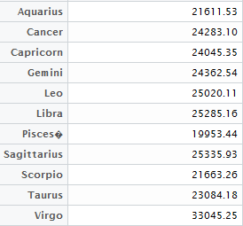
tapply
Calculate mean, median, min, max, etc.. of a numerical attribute for all categories of a categorical attribute
zodiac.gainavg<-tapply(ZodiacChallenge$CAPITALGAINS,ZodiacChallenge$ZODIAK,mean)
Computes mean of Capital Gains for all Zodiac signs

Slide 4
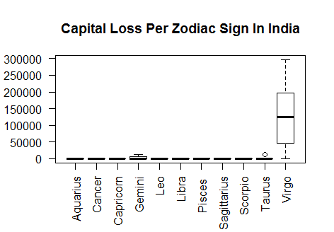
Zodiac Challenge: Pattern 1
1. zo.ind <- subset(ZodiacChallenge, NATIVE == 'India')
2. boxplot(zo.ind$CAPITALLOSS~zo.ind$ZODIAK,las=2, main='Capital Loss Per Zodiac Sign In India')
Indian Virgos suffer most capital loss

Slide 5
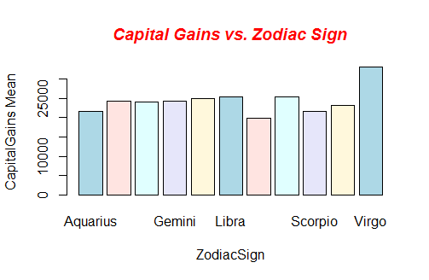
Zodiac Challenge: Pattern 2
1. CapitalGainsZodMean <- tapply(ZodiacChallenge$CAPITALGAINS, ZodiacChallenge$ZODIAK, mean)
2. barplot(CapitalGainsZodMean, main = "Capital Gains vs. Zodiac Sign", font.main = 4, col.main = "red", xlab = "ZodiacSign", ylab = "CapitalGains Mean", col = c("lightblue", "mistyrose", "lightcyan", "lavender", "cornsilk"))
Virgos have highest capital gain mean

Slide 6
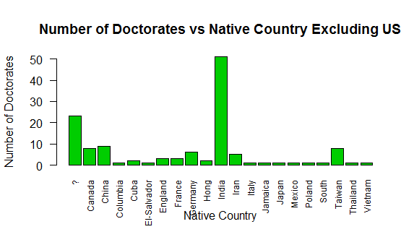
Zodiac Challenge: Pattern 3
1. zo.exceptUS<-subset(ZodiacChallenge, NATIVE!="United-States")
2. Doctors<-subset(zo.exceptUS,EDUCATION=="Doctorate")
3. DoctorsByNative = table(Doctors$EDUCATION,Doctors$NATIVE)
4. barplot(DoctorsByNative, main = "Number of Doctorates vs Native Country Excluding US", col = 3 ,ylab = "Number of Doctorates", xlab = "Native Country", las = 2, cex.names = 0.75)
Indians have highest number of doctorates, not considering US

Slide 7
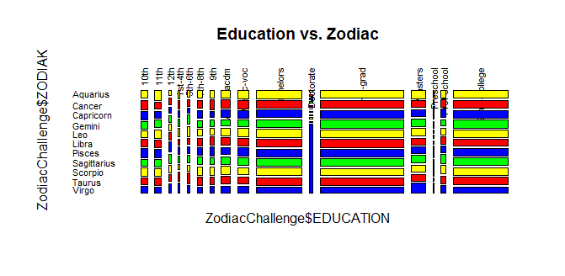
Zodiac Challenge: Pattern 4
mosaicplot(ZodiacChallenge$EDUCATION~ZodiacChallenge$ZODIAK, main="Education vs. Zodiac", shade = F, color=c("Yellow","Red","Blue","Green"),las=2)
Most Doctorates are Virgos.

Slide 8
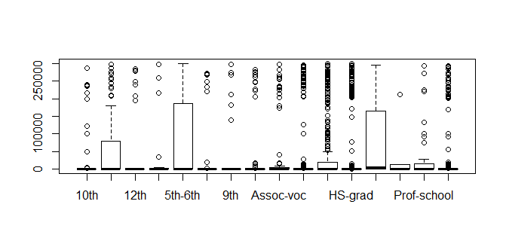
Zodiac Challenge
zo.except5<-subset(ZodiacChallenge, select = c(1:4,6:9))
zo.except5.virgo<-subset(ZodiacChallenge, select = c(1:4,6:9), ZODIAK=="Virgo")
boxplot(zodiac.challenge$CAPITALGAINS~zodiac.challenge$EDUCATION)
Not all plots are informative.

